Slide 1


Chowgacha -Jhenaidah model is the best example of community participation
Dr. Md.Emdadul Haque
National Consultant(HEU) .
M0HFW

Slide 2
Comparative data of health facilities of different countries of the world
SL NO | Country | Per capita health Expenditure per year by Govt. ($) | %GDP budget used in health | Total halth budget | Total population in 2018. | Out of pocket expenditure
01 | USA | 11462 | 17.6 | 3600 Bil |  | 11.08
02 | UK | 4270 | 9.9 | 252 .5Bil |  | 14.79
03 | Malay | 426 | 3.75 | 26.58 Bil |  | 36.67
04 | Sri Lanka | 162 | 2.9 | 85.1 Mil |  | 38.43
05 | India | 60 | 2.95 | 14.7Bil |  | 65.06
06 | Nepal | 51 | 4.53 | 510 Mil |  | 60.41
07 | Pakistan | 43 | 3.2 | 1.84 Bil |  | 66.49
08 | Bangladesh | 42 | 2.5 | 2.49 Bil |  | 67

Slide 3
Comparative data of HR of different SAARC countries(Doctors , Nurses & Midwives)
World Health Bulletin 2022

Slide 4
A Hospital with a Vision …
Maximum utilization of Govt.
resources with
honesty and sincerity.
Integrated approach of
Administration, Community
Leaders .
Providing Effective services
through improved
management system.

Slide 5
Background History of Chowgacha Health Complex,Model
*Choowgacha UHC Model starts in 1985 and effectively in Feb. 1996.
*From January 1995 to 1997 JICA by Frontline MCH Program to by giving technical and logistic supports.
* From 1998 DGHS & UNICEF have continued the support.
<4 Special activities>
ANC-Corner
Basic EOC service
Under 5 corner for under 5 children
Monthly birth and death record
#

Slide 6





CHOWGACHA UHC-Through the Ages
Old UHC
Old UHC
50-bedded UHC
31-bedded UHC

Slide 7


Blood donation program stared in 16 December, 1996 in Chowgacha UHC
A seminar on ‘Importance of birth & death registration and prevention of early marriage’ at Chowgacha Degree College in June, 1997. DC Jessore was the chief guest.

Slide 8


Innovations of Chowgacha Health Complex
Cycle stand near the entrance
“Pushti Tray” – Nutritional Education

Slide 9


Citizen Charter

Slide 10


Daily Activities
Labour Ward with 41=(11+30) beds
Rest room for pregnant mothers

Slide 11




Community Participation

Slide 12

Upazila Health Complex
CHOWGACHA , JESSORE.
EOC Activities : 1997- 2011 (ANC First Visit)

Slide 13

Upazila Health Complex
CHOWGACHA , JESSORE.
EOC Activities : 1997- 2011 (Hospital Delivery )

Slide 14
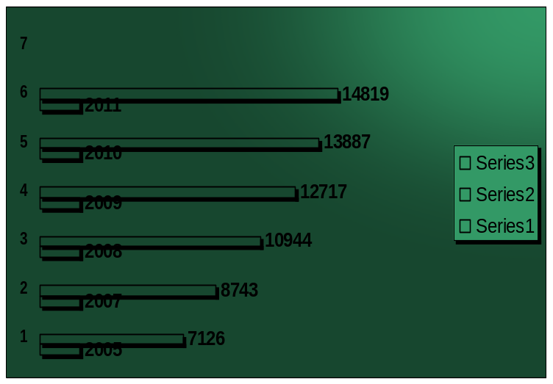
Upazila Health Complex
CHOWGACHA , JESSORE.
Indoor Service 2005 to 2011
Sl No | Year | indoor Service | No of Bed | Bed occupancy rate
01 | 2005 | 7126 | 31 | 158.0%
02 | 2007 | 8743 | 31 | 201.0%
03 | 2008 | 10944 | 50 | 199.0%
04 | 2009 | 12717 | 50 | 185.0%
05 | 2010 | 13887 | 50 | 200.0%
06 | 2011 | 14819 | 50 | 208.0%

Slide 15
UHC,CHOWGACHA,JASHORE.
Comparative Data of Delivery of best performing EOC center of Khulna Division in 2011
SL No | Name of institute | NVD | Vacuum Del. | V. Breech | C. Section | Total
01. | Chowgacha UHC | 3346 | 34 | 26 | 1007 | 4413
02. | Ad-din Hospital Jessore. | 1424 | 0 | 0 | 1864 | 3288
03. | Khulna Medical College Hospital | 1581 | 58 | 18 | 1356 | 3013
04. | 250 bed Hospital, Jessore | 1327 | 2 | 25 | 1498 | 2852
05. | 250 bed Hospital, Kustia | 1728 | 0 | 34 | 915 | 2677
06. | Fatima Hospital Jessore. | 519 | 0 | 6 | 1061 | 1586

Slide 16
Upazilla Health Complex
CHOWGACHA , JESSORE.
COMMUNITY SUPPORTED MANPOWER
TOTAL :46
  Volunteers :26
  Cleaners & guards :16
  Others :04
  The remunerations come from
  Outsourcing :25
  Service provider :21
  The amount of remuneration ranging from 200/= To 8000/=tk. Per month depending upon the style of work, which costs a total of nearly 90,ooo/=Tk per month.

Slide 17






Slide 18


Visit by Dignitaries – UHC Chowgacha
Honorable Health Minister Prof Dr. Ruhul Haque
MP with WHO Representative handing over
money and gift of voucher scheme of DSF
Secretary of MOHFW A.K.M. Zaforullah Khan
declared “Chowgacha UHC model” in DSF
voucher distribution ceremony on 20 June-2008

Slide 19
Criteria Of C-J Model.
Criteria of C-J Model | Best | good | Weak
1.Cycle stand close to the main gate.
2.Health Education
3.Cleanliness & beautification
4.Separation of patients in out door & indoor
5.Blood doner list with 24/7 B.T facility
6.Birth- death recording

Slide 20
Criteria of C-J Model.
Criteria of C-J Model. | Best | Good | Week
7. Reception Desk
8 . Developed Emergency Dept.
9. 5S –KAIZEN implementation.
10. Community Participation./Social welfare committee
11. Hospital activities Display
12. Corner based service.6/7 EPI.
13. Cash counter for receiving Govt money.

Slide 21
Criteria of C-J Model.
Criteria of C-J Model. | Best | Good | Week
14.Devolped maternal health/labour word.
15.Devolped paediatric health
16.Position in HSS score
17. Power point Presentation &Video on UHC
18.Knowledge about 8th Five Year plan & SDG.
19.Zero-Tollarance on corruption

Slide 22
Acheivement of Chowgacha UHC
Chowgacha UHC awarded for EPI in 1988,” Best PerformanceAward” in EOC form 2005 to 2014 & Health Ministers Award stood 1st in 2017, 2018 & 2020.
In 2008, Chowgacha Health Complex declared as the “Model Upazilla Health Complex by the M0HFW
  Chowgacha UHC became the best EOC center having 41(11+30) with 98.4%(4413) hospital delivery rate in 2011.
  The UHC starts upgrade to 100 bedded hospital
  Chowgacha UHC model is being replicated throughout the country by DGHS, MOH & FW since 2016 by the order of Prime Minister

Slide 23




Beautification of the Premises

Slide 24

100 kh¨v wewkó m`i nvmcvZvj, wSbvB`n

Slide 25
Challenges of the hospital in 2012
Insecured hospital environment.
Performance of all activities was very low.
Very limited support staff.
3 doctors including RMO was suspended.
48 Non-gov. staff. demanding money from the patients.
Waste management system was poor.
Monitoring meeting was not performed regularly

Slide 26
Bed Occupancy Rate from 1998 to 2019

Slide 27


Emergency + Out Door & Indoor Service 1998 to 2019
Emergency + Outdoor visit, Indoor (admission)

Slide 28
Total ANC and Delivery in Jhenaidah District Hospital 2011-2019

Slide 29
3 best performing EmOC Hospital in Khulna division - 2017
Sadar Hospital, Jhenaidah

Slide 30


Visit to Shatkhira District Hospital and Introduction of TQM activities
A team of Jhenaidah District hospital visited to Shatkhira District hospital in 2014
A meeting was held in Shatkhira District conference room

Slide 31






Changes in Pediatric Ward and EOC Ward in 2014.
Before
After

Slide 32




Waste Management & Campus Protection -2012
Before
After
Before
After

Slide 33




Use of color code, alignment of picture & monthly meeting schedule.
Color code
Color code
Monthly meeting schedule
Alignment of pictures

Slide 34


Innovative activities of Jhenaidah Sadar Hospital - 1
Creation of awareness towards Health Education for the patients and their attendances.
Motivation of the community, the teachers, reporters, social workers, cultural activists and donors of the hospital .

Slide 35




Innovative activities community supported manpower - 2
Trolley man
Cleaner
Guard
Nursing aid

Slide 36




Involvement of MP, District Administrator & Mayor in Sadar Hospital
Perticipation of Previous MP in beautification
DC, Jhenaidah Visited Sadar Hospital
A big cleaning day on 17 March
Crowd control by scout

Slide 37




Improved pediatric word by local initiative

Slide 38



Innovation in Medicine Ward by the consultants.

Slide 39




Innovative activities of Jhenaidah Sadar Hospital - 6
Intercom system by community sup.
Generator by community sup.
Pcikup van by Jahedee Foundation
Extension of hospital mosque

Slide 40
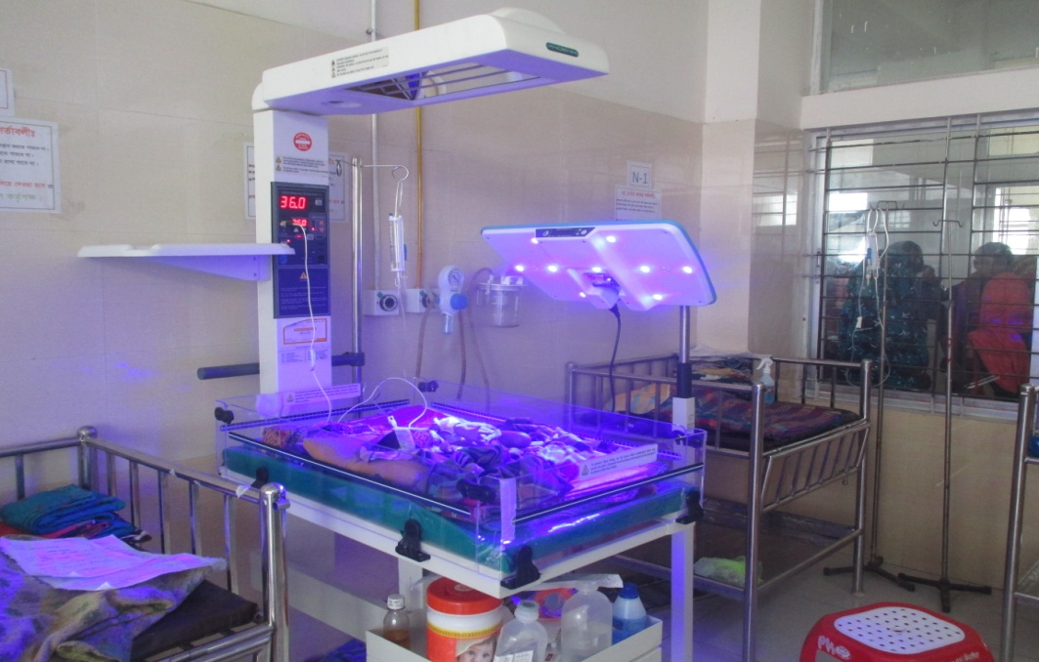
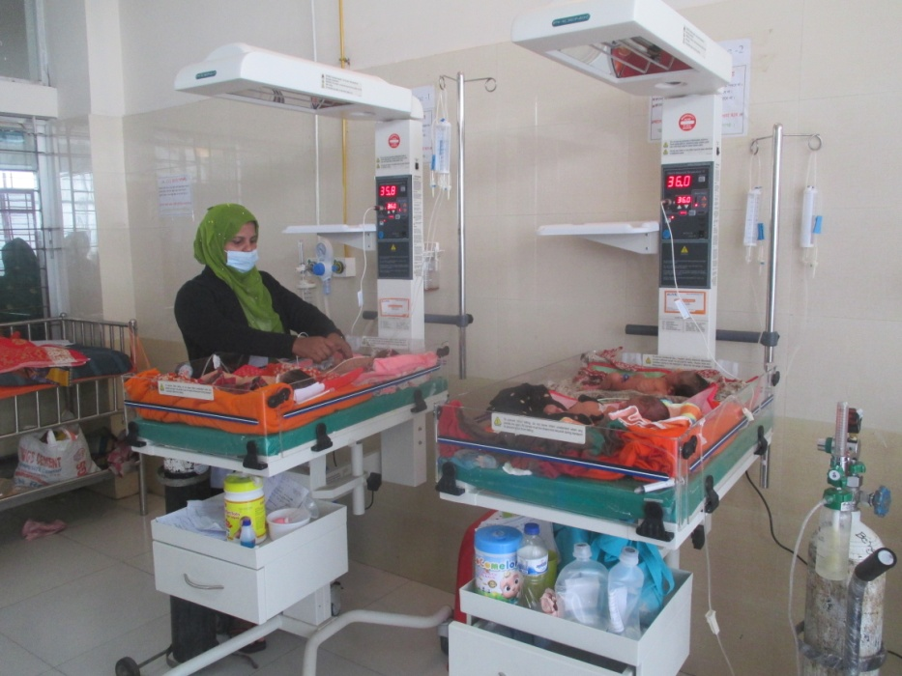
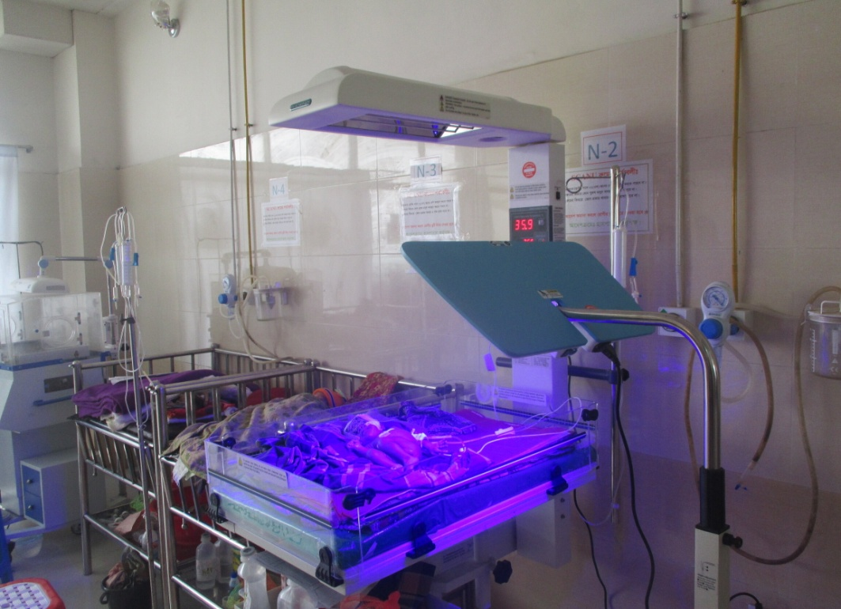
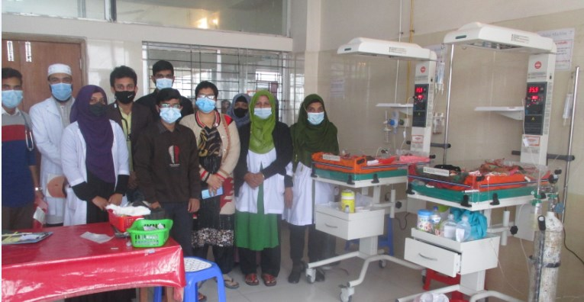
Improved pediatric word by local initiative in 2021.

Slide 41
Community Support System in Sadar Hospital
Staff : 53
  Cleaner: 20
  Aya /Word boy: 21
  Security guard: 6
  Volunteer: 3
  Trolley man: 3
Generator.
Intercom.
Biochemical analyzer.
Reformation of medicine, surgery, pediatric word.
Boundary wall repair.
Pic up car.
Donors:
MP.
Mayor.
Zahedee Foundation.
Doctors.
Other donors
Retd. Secretary .

Slide 42
Achievement of the Hospital
1. Active Community Participation in health service is an example in Bangladesh.
2. Improved performance of all IPD & OPD services.
3. Improved cleanliness and beautification of campus.
4.. The hospital is awarded 7 times from 2013 to 2020.
5. Improved Security.
6. Improved financial management
7. Replication of C- J Model by DGHS in 20 District hospital & 40 UHC.

Slide 43
7th Five Year Plan, Health, Nutrition and Population Target
_{SL No.} | _{Indicator (effect/ results)} | _{Start Year Info (Start Year)} | The target of 7th Five-Year Plan is only by 2022 | _{SDG by 2030}
1 | life expectancy at birth (in year) | 70.4 (SVRS 2013) | 72
2 | Under five mortality rate (per 1000 live birth) | 46 (BDHS 2014) | 37 | 25
3 | Infant (0-1 yr) mortality rate (per 1000 live births) | 38 (BDHS 2014) | 20
4 | Maternal mortality ratio (per 100000 live birth) | 170 (MMEIG 2013) | 105 | 70
5 | The ratio of underweight children under 5 years (%) | 32.6 (BDHS 2014) | 20
6 | Ratio of stunting in under 5 years children (%) | 36.1 (BDHS 2014) | 25
7 | Total fertility rate (children per head of every woman of reproductive age) | 2.3 (BDHS 2014) | 2.0

Slide 44
8 | Contraceptive prevalence rate (%) | 62.4 (BDHS 2014) | 75
9 | Immunization coverage among Children under the age of one year | 78 | 95
10 | Ratio of childbirth (%) delivery by trained person | 42.1 (BDHS 2014) | 65
11 | Rate of institutional delivery according to wealth status (ratio of highest and lowest fifth) | 15:69.5 (BDHS 2014) | 1:3.5
12 | Tuberculosis identification rate (%) | 53 (GTR 2014) | 75
13 | Neonatal mortality rate per 1000 live birth | 25 (2014) | 18 | 12
14 | The wasting rate of children aged under five years | 14 | 12
15 | Ante-natal Health Care (ANC) 4th visit | 31.2 | 50

Slide 45
_{SL No.} | _{Indicator (effect/ results)} | _{Start Year Info (Start Year)} | The target of 7th Five-Year Plan is only by 2022 | _{SDG by 2030}
16 | Exclusive Breastfeeding infant under 6 months | 55.3 (2014) |  | 16
17 | Adolescent fertility rate (15-19) per 1000 married couple | 31 | 25 | 17
18 | Deaths due to NCD per ten thousand population (30 - 69 years) |  |  | 18
18. a | Heart disease |  |  | 18. a
18 b | Cancer |  |  | 18 b
18 c | Diabetes |  |  | 18 c
18 d | Chronic respiratory illness |  |  | 18 d

Slide 46

Thank You
আমাদের বাগানের ফুল
Notes:
46

Slide 47
8th Five Year Plan, Health, Nutrition and Population Target
_{SL No.} | _{Indicator (effect/ results)} | Start Year Info (Start Year2019) | The target of 8th Five-Year Plan is only by 2025 | _{SDG by 2030}
1 | life expectancy at birth (in year) | 72.6 (SVRS 2019) | 74
2 | Under five mortality rate (per 1000 live birth) | 28(SVRS-2019) | 27 | 25
3 | Infant (0-1,year) mortality rate (per 1000 live births) | 21(SVRS 2019) | 18
4 | Maternal mortality ratio (per 100000 live birth) | 165 (SVRS-2019) | 100 | 70
5 | The ratio of underweight children under 5 years (%) | 32.6 (BDHS 2014) | 20
6 | Ratio of stunting in under 5 years children (%) | 28%(MICS- 2019) | 25
7 | Total fertility rate (children per head of every woman of reproductive age) | 2.04(SVRS- 2019) | 2.0

Slide 48
8 | Contraceptive prevalence rate (%) | 63.4 (SVRS -2019) | 75
9 | Immunization coverage among Children under the age of one year(%) | 86 (%) | 98(%)
10 | Ratio of childbirth (%) delivery by trained person | 59 (MICS- 2019) | 72
11 | Rate of institutional delivery according to wealth status (ratio of highest and lowest fifth) | 1:3 (BDHS 2019) | 1:1.5
12 | Tuberculosis incidance rate /1,00,000 pop. | 221(GTR-2019) | 112
13 | Neonatal mortality rate per 1000 live birth | 15 (SVRS-2019) | 14 | 12
14 | Mortality rate by NCD(Cardiovascular, Cancer Diabetis, Chorinicrespiratory illness) (%) | 21.6(WHO-2019) | 16.8
15 | Ante-natal Health Care (ANC) 4th visit

Slide 49
_{SL No.} | _{Indicator (effect/ results)} | _{Start Year Info (Start Year)} | The target of 7th Five-Year Plan is only by 2025 | _{SDG by 2030}
19 | Mortality in road traffic accidents (per 100,000 population)
19a. | Male
19 b. | Women
20. | Smoker's rate (every 100,000 population) in 15+ years

Slide 50
Visit by Dignitaries – UHC Chowgacha
Honorable Health Minister Prof Dr. Ruhul Haque
MP with WHO Representative handing over
money and gift of voucher scheme of DSF
Secretary of MOHFW A.K.M. Zaforullah Khan
declared “Chowgacha UHC model” in DSF
voucher distribution ceremony on 20 June-2008

Slide 51

Our usual solution:
We need more RESOURCES!!!!

